Slide 1
COMPLETE
BUSINESS
STATISTICS
by
AMIR D. ACZEL
&
JAYAVEL SOUNDERPANDIAN
7th edition.
Prepared by Lloyd Jaisingh, Morehead State University
Chapter 12
Time Series, Forecasting, and Index Numbers
McGraw-Hill/Irwin
Copyright © 2009 by The McGraw-Hill Companies, Inc. All rights reserved.

Slide 2
_{12-<number>}
12
Time Series, Forecasting, and Index Numbers
Using Statistics
Trend Analysis
Seasonality and Cyclical Behavior
The Ratio-to-Moving-Average Method
Exponential Smoothing Methods
Index Numbers

Slide 3
_{12-<number>}
12
LEARNING OBJECTIVES
After studying this chapter you should be able to:
Differentiate between qualitative and quantitative methods of forecasting
Carry out a trend analysis in time series data
Identify seasonal and cyclical patterns in time series data
Forecast using simple and weighted moving average methods
Forecast using exponential smoothing method
Forecast when the time series contains both trend and seasonality
Assess the efficiency of forecasting methods using measures of error
Make forecasts using templates
Compute index numbers

Slide 4
12-2 Trend Analysis
_{12-<number>}
A time series is a set of measurements of a variable that are ordered through time. Time series analysis attempts to detect and understand regularity in the fluctuation of data over time.
Regular movement of time series data may result from a tendency to increase or decrease through time - trend- or from a tendency to follow some cyclical pattern through time - seasonality or cyclical variation.
Forecasting is the extrapolation of series values beyond the region of the estimation data. Regular variation of a time series can be forecast, while random variation cannot.

Slide 5
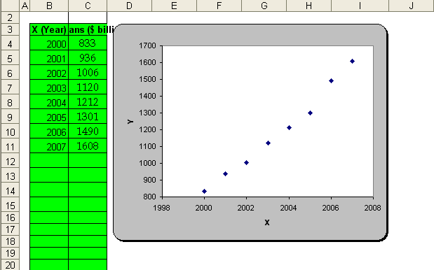
12-2 Trend Analysis: Example 12-1
_{12-<number>}
As can be seen
from the figure, the
observations may be
described by a
straight line. A simple
linear regression
equation is fit to the
data by least squares.
A straight-line model
to account for a trend
is of the form
Z_{t} = β₀ + β₁t + a_{t}

Slide 6
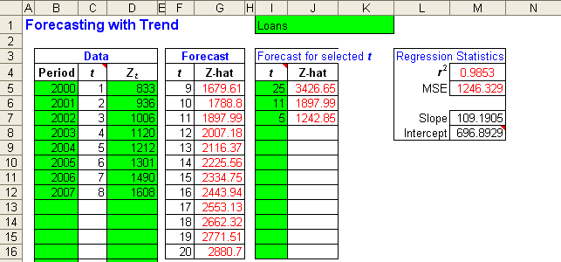
12-2 Trend Analysis: Example 12-1
_{12-<number>}
The following output was obtained using the template.
Linear Model: Z_{t} = 696.89 + 109.19t
Note: The template contains forecasts for t = 9 to t = 20 which corresponds to years 2008 to 2019.

Slide 7
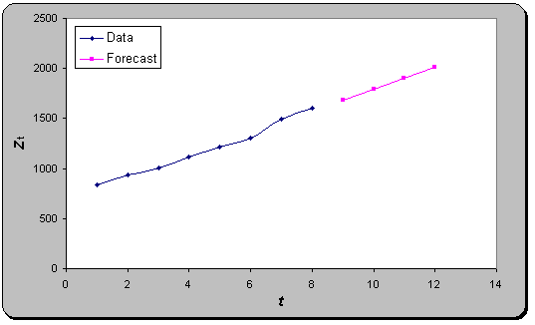
12-2 Trend Analysis: Example 12-1
_{12-<number>}
Straight line trend.

Slide 8
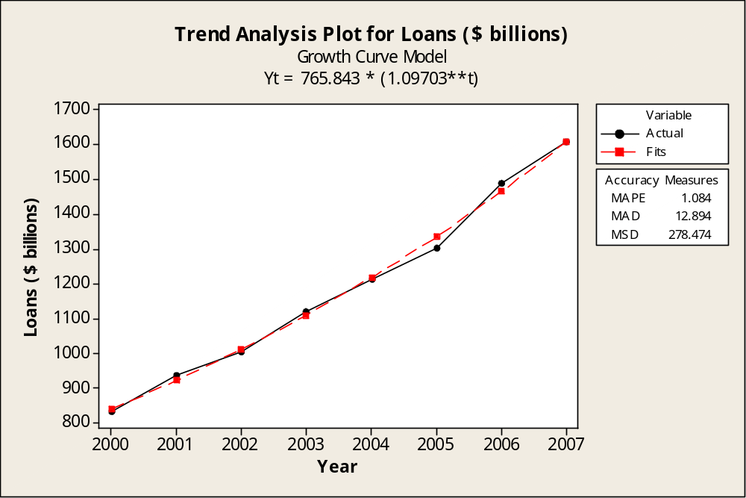
12-2 Trend Analysis: Example 12-1
_{12-<number>}
Growth Curve Model

Slide 9
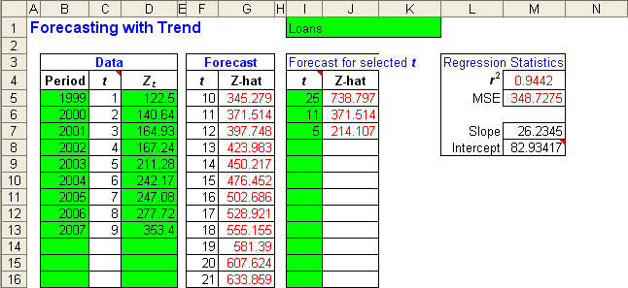
Example 12-2
_{12-<number>}
The forecast
for t = 10
(year 2008)
is 345.27
Observe that the forecast model is Z_{t} = 82.96 + 26.23t

Slide 10
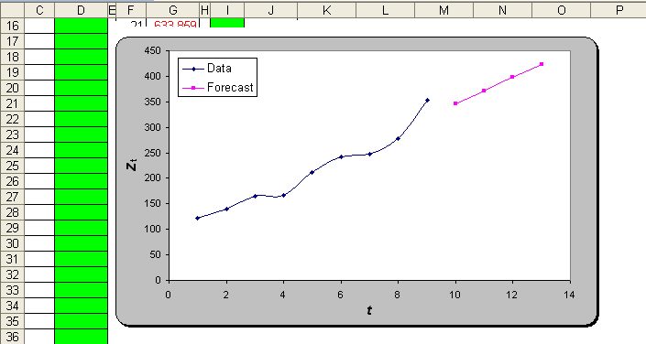
Example 12-2
_{12-<number>}
The forecast
for t = 10
(year 2008)
is 345.27
The forecast model is Z_{t} = 82.96 + 26.23t

Slide 11
12-3 Seasonality and Cyclical Behavior
_{12-<number>}
M
o
n
t
h
l
y
S
a
l
e
s
o
f
S
u
n
t
a
n
O
i
l
G
r
o
s
s
E
a
r
n
i
n
g
s
:
A
n
n
u
a
l
M
o
n
t
h
l
y
N
u
m
b
e
r
s
o
f
A
i
r
l
i
n
e
P
a
s
s
e
n
g
e
r
s
2
0
0
2
0
1
1
0
0
0
1
0
0
0
s
s
0
g
r
s
1
e
e
n
5
g
i
n
9
0
0
l
n
0
a
1
r
e
0
S
0
a
s
E
s
8
0
0
1
a
0
0
P
7
0
0
0
6
0
0
0
5
0
t
J
86
87
88
89
90
91
92
93
94
95
F
M
A
M
J
J
A
S
O
N
D
J
F
M
A
M
J
J
A
S
O
N
D
J
F
M
A
M
J
J
A
8
0
8
1
8
2
8
3
8
4
8
5
8
6
8
7
8
8
8
9
9
0
9
1
9
2
9
3
9
4
9
5
Y
e
a
T
r
i
m
e
When a cyclical pattern has a period of one year, it is usually called seasonal variation. A pattern with a period of other than one year is called cyclical variation.

Slide 12
Time Series Decomposition
_{12-<number>}
Types of Variation
  Trend (T)
  Seasonal (S)
  Cyclical (C)
  Random or Irregular (I)
Additive Model
  Z_{t} = T_{t} + S_{t} + C_{t} + I_{t}
Multiplicative Model
  Z_{t} = (T_{t} )(S_{t} )(C_{t} )(I_{t})

Slide 13
Estimating an Additive Model with Seasonality
_{12-<number>}
An additive regression model with seasonality:
Z_{t}=β₀+ β₁ t+ β₂ Q₁+ β₃ Q₂ + β₄ Q₃ + a_{t}
where
Q₁=1 if the observation is in the first quarter, and 0 otherwise
Q₂=1 if the observation is in the second quarter, and 0 otherwise
Q₃=1 if the observation is in the third quarter, and 0 otherwise

Slide 14
12-4 The Ratio-to-Moving- Average Method
_{12-<number>}
A moving average of a time series is an average of a fixed number of observations that moves as we progress down the series.
Time, t: 1 2 3 4 5 6 7 8 9 10 11 12 13 14
Series, Z_{t}: 15 12 11 18 21 16 14 17 20 18 21 16 14 19
Five-period
moving average: 15.4 15.6 16.0 17.2 17.6 17.0 18.0 18.4 17.8 17.6
Time, t: 1 2 3 4 5 6 7 8 9 10 11 12 13 14
Series, Z_{t}: 15 12 11 18 21 16 14 17 20 18 21 16 14 19
(15 + 12 + 11 + 18 + 21)/5=15.4
(12 + 11 + 18 + 21 + 16)/5=15.6
(11 + 18 + 21 + 16 + 14)/5=16.0
. . . . .
(18 + 21 + 16 + 14 + 19)/5=17.6

Slide 15
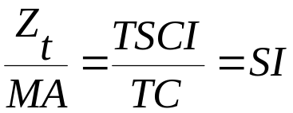
Comparing Original Data and Smoothed Moving Average
_{12-<number>}
O
r
i
g
i
n
a
l
S
e
r
i
e
s
a
n
d
F
i
v
e
-
P
e
r
i
o
d
M
o
v
i
n
g
A
v
e
r
a
g
e
s
Moving Average:
  “Smoother”
  Shorter
  Deseasonalized
    Removes seasonal and irregular components
  Leaves trend and cyclical components
2
0
Z
1
5
1
0
0
5
1
0
1
5
t

Slide 16
Ratio-to-Moving Average
_{12-<number>}
Ratio-to-Moving Average for Quarterly Data
  Compute a four-quarter moving-average series.
  Center the moving averages by averaging every consecutive pair and placing the average between quarters.
  Divide the original series by the corresponding moving average. Then multiply by 100.
  Derive quarterly indexes by averaging all data points corresponding to each quarter. Multiply each by 400 and divide by sum.

Slide 17
Ratio-to-Moving Average: Example 12-3
_{12-<number>}
Simple Centered Ratio
Moving Moving to Moving
Quarter Sales Average Average Average
2004W 170 * * *
2004S 148 * * *
2004S 141 * 151.125 93.3
2004F 150 152.25 148.625 100.9
2005W 161 150.00 146.125 110.2
2005S 137 147.25 146.000 93.8
2005S 132 145.00 146.500 90.1
2005F 158 147.00 147.000 107.5
2006W 157 146.00 147.500 106.4
2006S 145 148.00 144.000 100.7
2006S 128 147.00 141.375 90.5
2006F 134 141.00 141.000 95.0
2007W 160 141.75 140.500 113.9
2007S 139 140.25 142.000 97.9
2007S 130 140.75 * *
2007F 144 143.25 * *
F
o
u
r
-
Q
u
a
r
t
e
r
M
o
v
i
n
g
A
v
e
r
a
g
e
s
1
7
0
A
c
t
u
a
l
S
m
o
o
t
h
e
d
A
c
t
u
a
l
1
6
0
S
m
o
o
t
h
e
d
s
e
l
1
5
0
a
S
1
4
0
M
o
v
i
n
g
A
v
e
r
a
g
e
L
e
n
g
t
h
:
4
1
3
0
M
A
P
E
:
7
.
8
1
6
M
A
D
:
1
0
.
9
5
5
M
S
D
:
1
5
2
.
5
7
4
0
5
1
0
1
5
T
i
m
e

Slide 18
Seasonal Indexes: Example 12-3
_{12-<number>}
Quarter
Year Winter Spring Summer Fall
2004 93.3 100.9
2005 110.2 93.8 90.1 107.5
2006 106.4 100.7 90.5 95.0
2007 113.9 97.9
Sum 330.5 292.4 273.9 303.4
Average 110.17 97.47 91.3 101.13
Sum of Averages = 400.07
Seasonal Index = (Average)(400)/400.07
Seasonal
Index 110.15 97.45 91.28 101.11

Slide 19
Deseasonalized Series: Example 12-3
_{12-<number>}
O
r
i
g
i
n
a
l
a
n
d
S
e
a
s
o
n
a
l
l
y
A
d
j
u
s
t
e
d
S
e
r
i
e
Seasonal Deseasonalized
Quarter Sales Index (S) Series(Z/S)*100
2004W 170 110.15 154.34
2004S 148 97.45 151.87
2004S 141 91.28 154.47
2004F 150 101.11 148.35
2005W 161 110.15 146.16
2005S 137 97.45 140.58
2005S 132 91.28 144.51
2005F 158 101.11 156.27
2006W 157 110.15 142.53
2006S 145 97.45 148.79
2006S 128 91.28 140.23
2006F 134 101.11 132.53
2007W 160 110.15 145.26
2007S 139 97.45 142.64
2007S 130 91.28 142.42
2007F 144 101.11 142.42
s
1
7
0
1
6
0
s
e
l
1
5
a
0
S
1
4
0
1
3
0
1
9
9
2
W
1
9
9
2
S
1
9
9
2
S
1
9
9
2
F
t
Original
Deseasonalized - - -

Slide 20
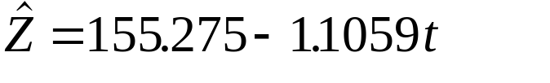
The Cyclical Component:
Example 12-3
_{12-<number>}
T
r
e
n
d
L
i
n
e
a
n
d
M
o
v
i
n
g
A
v
e
r
a
g
e
s
The cyclical component is the remainder after the moving averages have been detrended. In this example, a comparison of the moving averages and the estimated regression line:
illustrates that the cyclical component in this series is negligible.
1
8
0
1
7
0
s
1
6
0
e
l
a
1
5
0
S
1
4
0
1
3
0
1
2
0
1
9
9
2
W
1
9
9
2
S
1
9
9
2
S
1
9
9
2
F
t

Slide 21
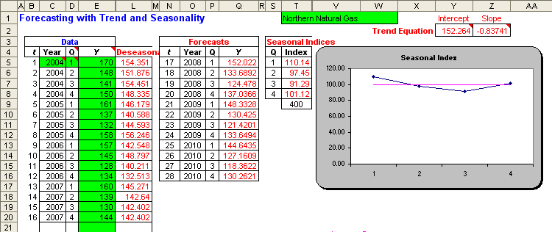
Example 12-3 using the Template
_{12-<number>}
The centered moving average, ratio to moving average, seasonal index, and deseasonalized values were determined using the Ratio-to-Moving-Average method.
This is a partial output for the quarterly forecasts.

Slide 22
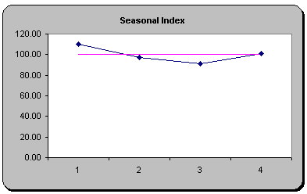
Example 12-3 using the Template
_{12-<number>}
Graph of the quarterly Seasonal Index

Slide 23
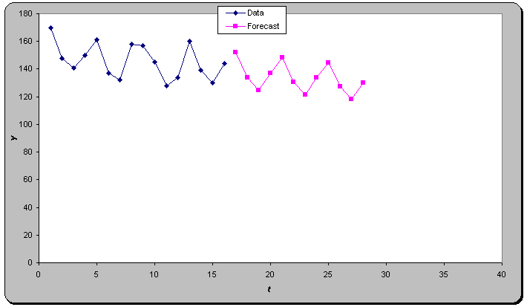
Example 12-3 using the Template
_{12-<number>}
Graph of the Data and the quarterly Forecasted values

Slide 24
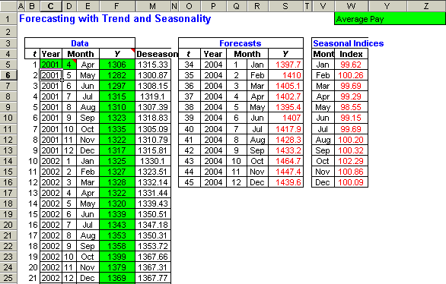
Example 12-3 using the Template
_{12-<number>}
The centered moving average, ratio to moving average, seasonal index, and deseasonalized values were determined using the Ratio-to-Moving-Average method.
This displays just a partial output for the monthly forecasts.

Slide 25
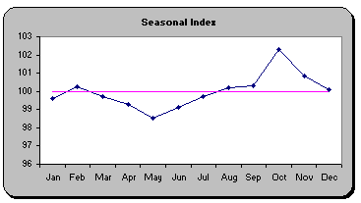
Example 12-3 using the Template
_{12-<number>}
Graph of the monthly Seasonal Index

Slide 26
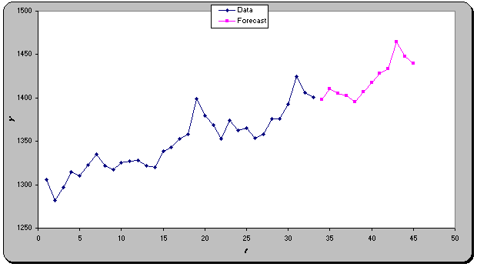
Example 12-3 using the Template
_{12-<number>}
Graph of the Data and the monthly Forecasted values

Slide 27
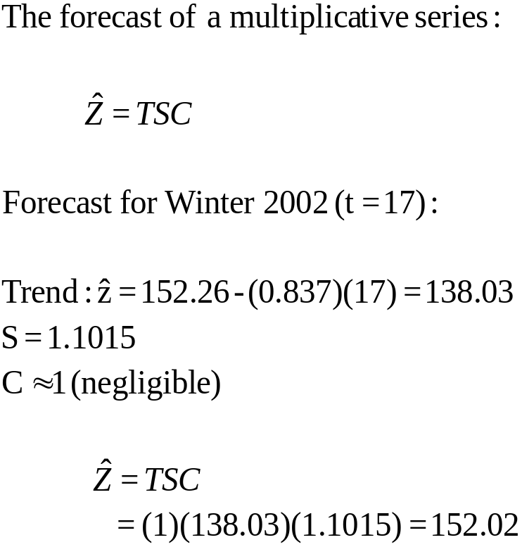
Forecasting a Multiplicative Series: Example 12-3
_{12-<number>}

Slide 28
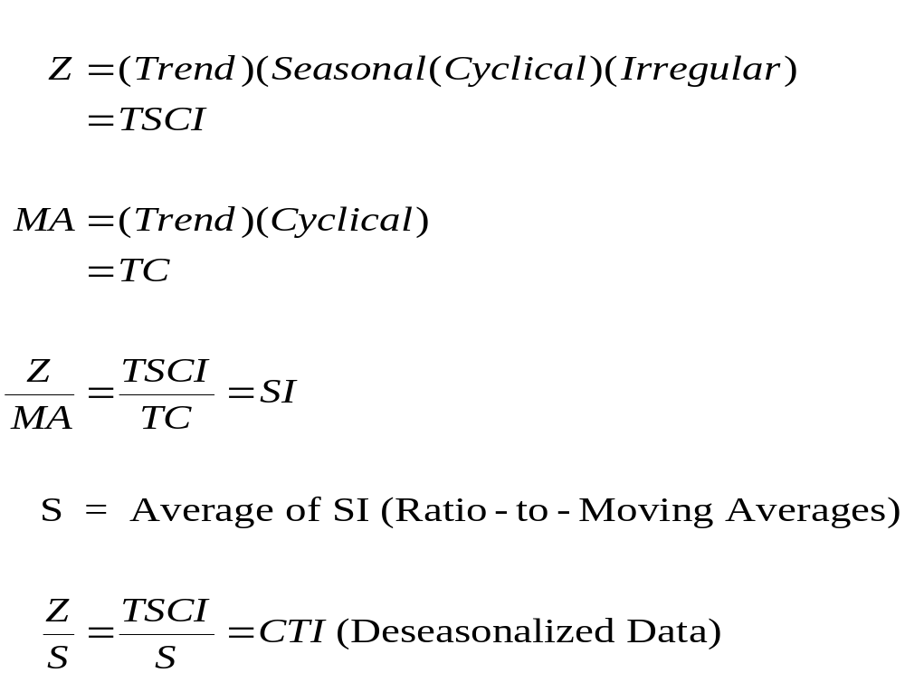
Multiplicative Series: Review
_{12-<number>}

Slide 29
12-5 Exponential Smoothing Methods
_{12-<number>}
Smoothing is used to forecast a series by first removing sharp variation, as does the moving average.
Weights Decline as we go back in Time
Exponential smoothing is a forecasting method in which the forecast is based in a weighted average of current and past series values. The largest weight is given to the present observations, less weight to the immediately preceding observation, even less weight to the observation before that, and so on. The weights decline geometrically as we go back in time.
W
e
i
g
h
t
s
D
e
c
l
i
n
e
a
s
W
e
G
o
B
a
c
k
i
n
T
i
m
e
a
n
d
S
u
m
t
o
1
0
.
4
t
0
.
3
Weight
h
g
i
e
0
.
2
W
0
.
1
0
.
0
-
1
5
-
1
0
-
5
0
L
a
g
-10
Lag
0

Slide 30
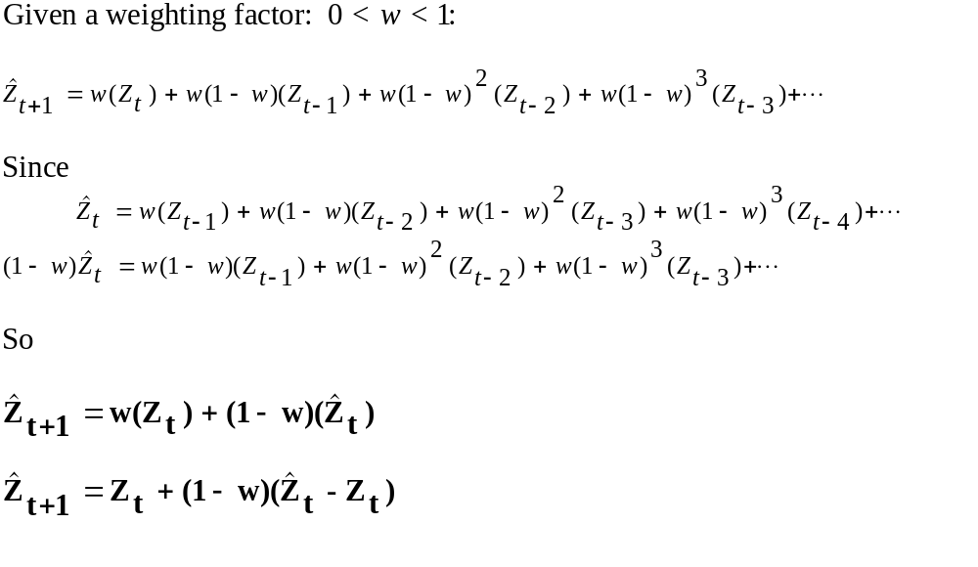
The Exponential Smoothing Model
_{12-<number>}

Slide 31
Example 12-4
_{12-<number>}
Day Z w=.4 w=.8
1 925 925.000 925.000
2 940 925.000 925.000
3 924 931.000 937.000
4 925 928.200 926.600
5 912 926.920 925.320
6 908 920.952 914.664
7 910 915.771 909.333
8 912 913.463 909.867
9 915 912.878 911.573
10 924 913.727 914.315
11 943 917.836 922.063
12 962 927.902 938.813
13 960 941.541 957.363
14 958 948.925 959.473
15 955 952.555 958.295
16 * 953.533 955.659
E
x
p
o
n
e
n
t
i
a
l
S
m
o
o
t
h
i
n
g
:
w
=
0
.
4
a
n
d
w
=
0
.
8
9
6
0
9
5
0
4
9
4
.
0
=
w
9
3
0
9
2
0
9
1
0
0
5
1
0
1
5
D
a
y
Original data:
Smoothed, w=0.4: ......
Smoothed, w=0.8: -----

Slide 32
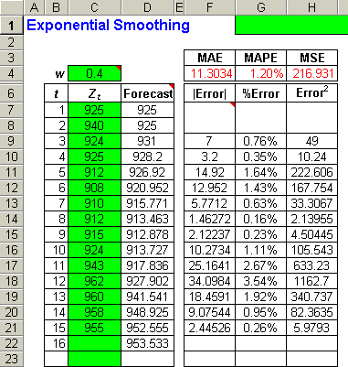
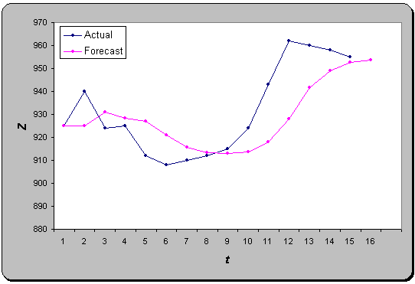
Example 12-4 – Using the Template
_{12-<number>}

Slide 33
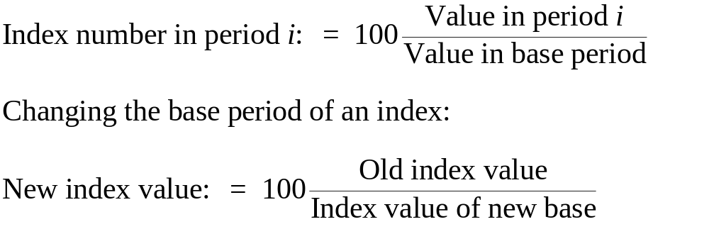
12-6 Index Numbers
_{12-<number>}
An index number is a number that measures the relative change in a set of measurements over time. For example: the Dow Jones Industrial Average (DJIA), the Consumer Price Index (CPI), the New York Stock Exchange (NYSE) Index.

Slide 34
Index Numbers: Example 12-5
_{12-<number>}
P
r
i
c
e
a
n
d
I
n
d
e
x
(
1
9
8
2
=
1
0
0
)
o
f
N
a
t
u
r
a
l
G
a
s
P
r
i
c
Index Index
Year Price 1984-Base 1991-Base
1984 121 100.0 64.7
1985 121 100.0 64.7
1986 133 109.9 71.1
1987 146 120.7 78.1
1988 162 133.9 86.6
1989 164 135.5 87.7
1990 172 142.1 92.0
1991 187 154.5 100.0
1992 197 162.8 105.3
1993 224 185.1 119.8
1994 255 210.7 136.4
1995 247 204.1 132.1
1996 238 196.7 127.3
1997 222 183.5 118.7
e
2
5
0
Original
e
Index (1984)
c
i
1
5
r
0
P
Index (1991)
5
0
1
9
8
5
1
9
9
0
1
9
9
5
Y
e
a
r

Slide 35
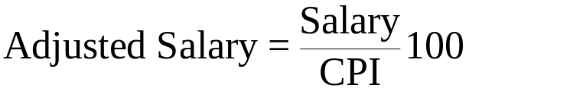
Consumer Price Index – Example 12-6
_{12-<number>}
Consumer Price index (CPI): 1967=100
Example 12-6:
Adjusted
Year Salary Salary
1980 29500 11953.0
1981 31000 11380.3
1982 33600 11610.2
1983 35000 11729.2
1984 36700 11796.8
1985 38000 11793.9
4
5
0
3
5
0
I
P
2
5
C
0
1
5
0
5
0
1
9
5
0
1
9
5
5
1
9
6
0
1
9
6
5
1
9
7
0
1
9
7
5
1
9
8
0
1
9
8
5
1
9
9
0
1
9
9
5
Y
e
a
r

Slide 36
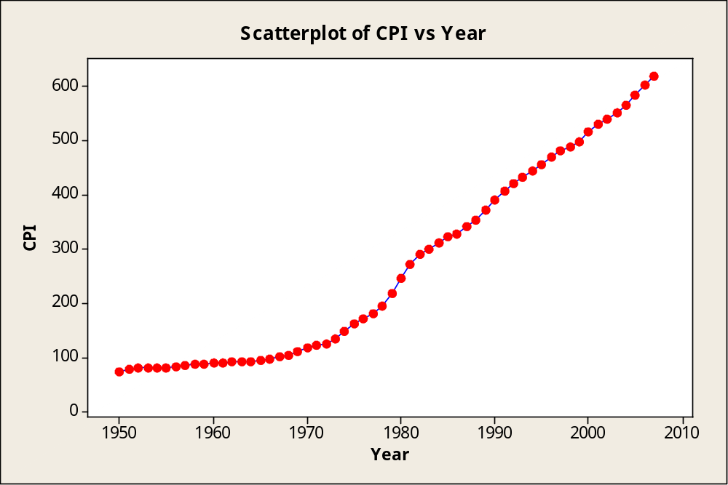
Consumer Price Index – Example 12-6
_{12-<number>}
Example 12-6:
Adjusted
Year Salary Salary
1980 29500 11953.0
1981 31000 11380.3
1982 33600 11610.2
1983 35000 11729.2
1984 36700 11796.8
1985 38000 11793.9

Slide 37
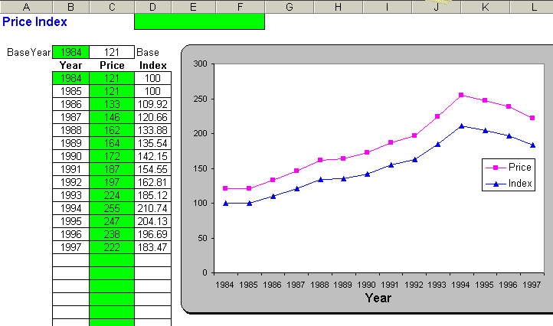
Example 12-6: Using the Template
_{12-<number>}

